Slide 1


Anastasiia Chernova
18.11.2024

Slide 2

Outline
Executive Summary
Introduction
Methodology
Results
Conclusion
Appendix

Slide 3
Executive Summary
Summary of methodologies
SpaceX Data Wranglin
SpaceX Data Collection using SpaceX API
SpaceX Data Collection with Web Scraping
SpaceX Exploratory Data Analysis using SQL
SpaceX Machine Learning Landing Prediction
SpaceX EDA DataViz using Python Pandas and Matplotlib
SpaceX Launch Sites Analysis with Folium-Interactive Visual Analytics and PlotyDash
Summary of all results
EDA results
Predictive Analysis (classification)
Interactive Visual Analytics and Dashbords

Slide 4
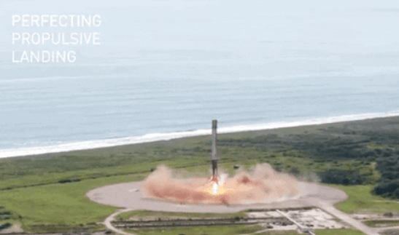
Introduction
Project background and context
SpaceX advertises Falcon 9 rocket launches on its website with a cost of 62 million dollars; other providers cost upward of 165 million dollars each, much of the savings is because SpaceX can reuse the first stage. Therefore if we can determine if the first stage will land, we can determine the cost of a launch. This information can be used if an alternate company wants to bid against SpaceX for a rocket launch.
Problems you want to find answers
In this work we will predict if the Falcon 9 first stage will successfully, using data from Falcon 9 rocket launchers advertised on its website.

Slide 5

Section 1

Slide 6
Methodology
Executive Summary
Data collection methodology:
The data from SpaceX were collected from the following resources:
SpaceX API (https://api.spacexdata.com/)
WebScraping (https://en.wikipedia.org/wiki/List_of_Falcon_9_and_Falcon_Heavy_launches
Perform data wrangling
Collected data were enriched by cresting a landing outcome lable based on outcome data after summarizing and analizyng features.
Perform exploratory data analysis (EDA) using visualization and SQL
Perform interactive visual analytics using Folium and Plotly Dash
Perform predictive analysis using classification models
Data wew collected until this step wewrw normalithed , divided in training and test dataset and evaluated by four different classification models

Slide 7
Data Collection
Describe how data sets were collected.
At first, data were collected using SpaceX API (RESTful API) by making a get request to the
SpaceX API. It was done by first defining a series helper functions that would help in the use
of the API to extract information using identification numbers in the launch data and then
requesting rocket launch data from the SpaceX API url.
To make the requested JSON results more consistent, the SpaceX launch data were
requested and parsed using the GET request and then decoded the response content as a Json result which was converted into a Pandas data frame.
Also performed web scraping to collect Falcon 9 historical launch records from a Wikipedia
page titled List of Falcon 9 and Falcon Heavy launches of the launch records are stored in a
HTML: Using BeautifulSoup and request Libraries, I extract the Falcon 9 launch HTML table
records from the Wikipedia page, Parsed the table and converted it into a Pandas data frame.

Slide 8
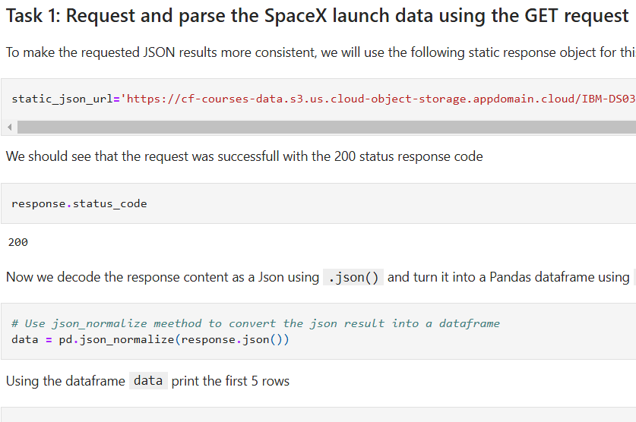
Data Collection – SpaceX API
Present your data collection with SpaceX REST calls using key phrases and flowcharts
Add the GitHub URL of the completed SpaceX API calls notebook (https://github.com/Anastasiia-Che/Lab-1-SpaceX-Falcon-9-first-stage-Landing-Prediction/blob/main/jupyter-labs-spacex-data-collection-api.ipynb), as an external reference and peer-review purpose
Place your flowchart of SpaceX API calls here

Slide 9
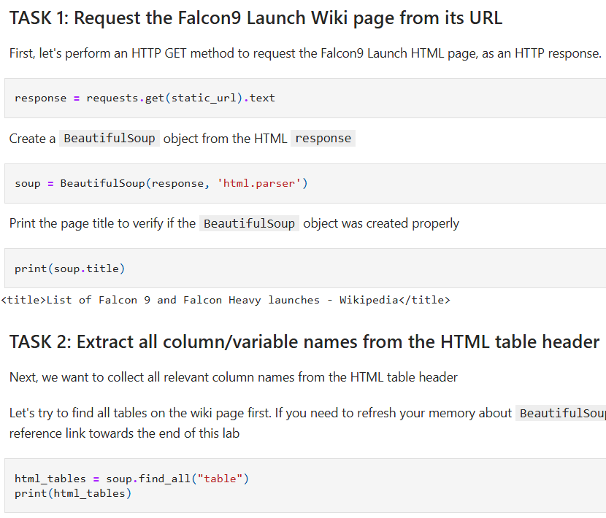
Data Collection - Scraping
Present your web scraping process using key phrases and flowcharts
GitHub URL of the completed web scraping notebook: https://github.com/Anastasiia-Che/Web-scraping-Falcon-9-and-Falcon-Heavy-Launches-Records-from-Wikipedia/blob/main/jupyter-labs-webscraping%20(1).ipynb
Place your flowchart of web scraping here

Slide 10
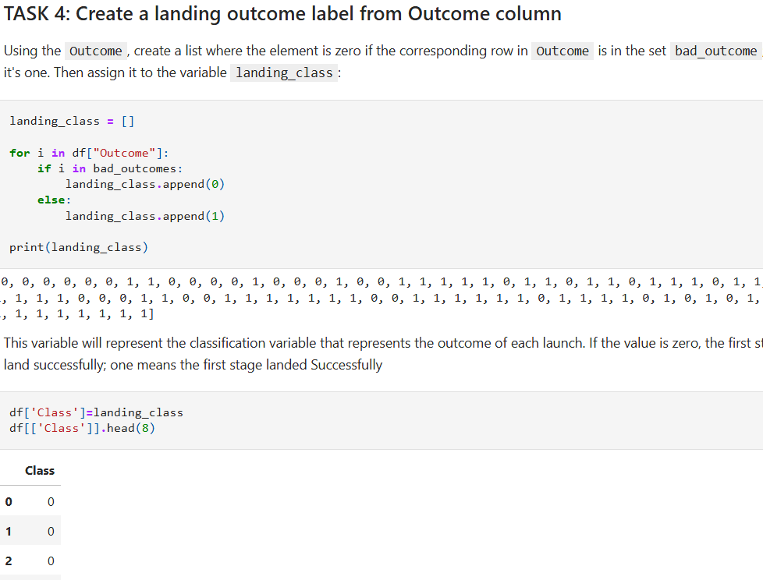
Data Wrangling
After obtaining and creating a Pandas DF from the collected data, data were filtered to only keep the Falcon 9 launches, then dealt with the missing data values in the LandingPad andbPayloadMass columns. Missing data values were replaced using mean value of column.
Performed some Exploratory Data Analysis (EDA) to find some patterns in the data and determine what would be the label for training supervised models.
GitHub URL of completed data wrangling related notebooks:
https://github.com/Anastasiia-Che/Lab-2-Data-wrangling/blob/main/labs-jupyter-spacex-Data%20wrangling.ipynb

Slide 11
EDA with Data Visualization
Data Analysis and Feature Engineering were performed using Pandas and Matplotlib:
Exploratory Data Analysis
Preparing Data Feature Engineering
To Visualize the relationship between Flight Number and Launch Site, Payload and Launch Site, FlightNumber and Orbit type, Payload and Orbit type were used scatter plots.
To Visualize the relationship between success rate of each orbit type was used Bar chart.
To Visualize the launch success yearly trend was used Line plot.
GitHub URL of completed EDA with data visualization notebook: https://github.com/Anastasiia-Che/EDA-with-Visualization-Lab/blob/main/edadataviz%20(1).ipynb

Slide 12
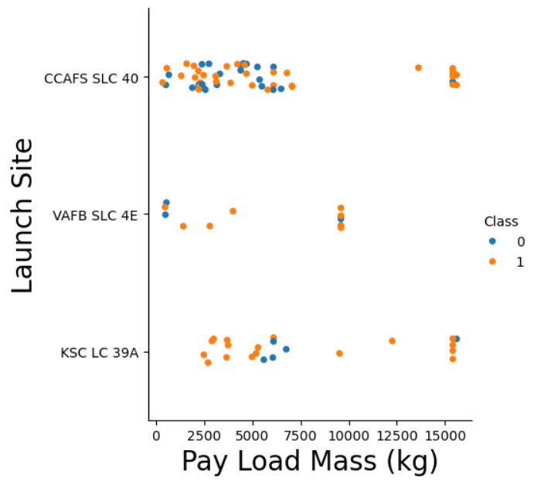
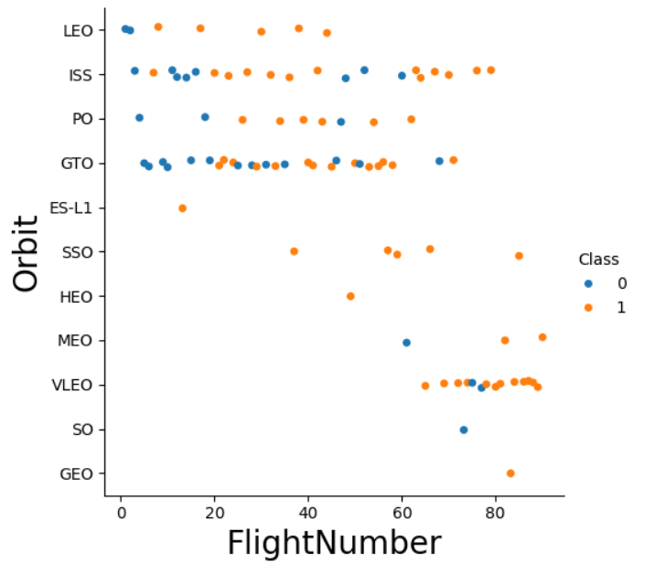
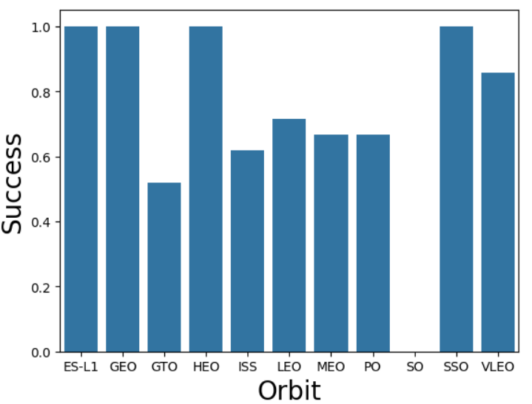
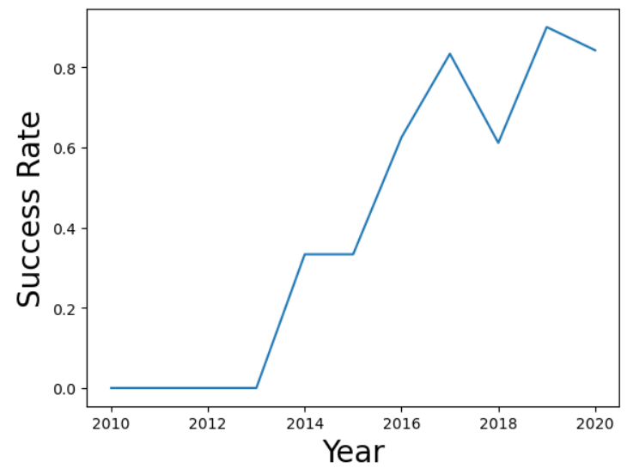
EDA with Data Visualization: Bar Chart, Line Chart, Scatter Plot

Slide 13
Display the names of the unique launch sites in the space mission
Display 5 records where launch sites begin with the string 'CCA
Display the total payload mass carried by boosters launched by NASA (CRS)
Display average payload mass carried by booster version F9 v1.1
List the date when the first succesful landing outcome in ground pad was acheived.
List the names of the boosters which have success in drone ship and have payload mass greater than 4000 but less than 6000
EDA with SQL

Slide 14
EDA with SQL
List the total number of successful and failure mission outcomes
List the names of the booster_versions which have carried the maximum payload mass. Use a subquery
List the records which will display the month names, failure landing_outcomes in drone ship ,booster versions, launch_site for the months in year 2015.
Rank the count of landing outcomes (such as Failure (drone ship) or Success (ground pad)) between the date 2010-06-04 and 2017-03-20, in descending order.
The GitHub URL of completed EDA with SQL notebook: https://github.com/Anastasiia-Che/Assignment-SQL-Notebook/blob/main/jupyter-labs-eda-sql-coursera_sqllite.ipynb

Slide 15
Build an Interactive Map with Folium
Created folium map to marked all the launch sites, and created map objects such as markers, circles, lines to mark the success or failure of launches for each launch site.
Markers indicate points like launch sites.
Circles indicate highlighted areas around specific coordinates, like NASA Johnson Space Center.
Marker clusters indicates groups of events in each coordinate, like launches in a launch site.
Lines are used to indicate distances between two coordinates.
Created a launch set outcomes (failure=0 or success=1).
The GitHub URL of completed interactive map with Folium map: https://github.com/Anastasiia-Che/Hands-on-Lab-Interactive-Visual-Analytics-with-Folium-lab/blob/main/lab_jupyter_launch_site_location.ipynb

Slide 16
Build a Dashboard with Plotly Dash
Built an interactive dashboard application with Plotly dash by:
Adding a Launch Site Drop-down Input Component.
Adding a callback function to render success-pie-chart based on selected site dropdown.
Adding a Range Slider to Select Payload.
Adding a callback function to render the success-payload-scatter-chart scatter plot.
The following graphs and plots were used to visualize data
Percentage of launches by site.
Payload range.
This combination allowed to quickly analyze the relation between payloads and launch sites, helping to identify where is best place to launch according to payloads.
The GitHub URL of completed Plotly Dash lab: https://github.com/Anastasiia-Che/Hands-on-Lab-Build-an-Interactive-Dashboard-with-Ploty-Dash

Slide 17
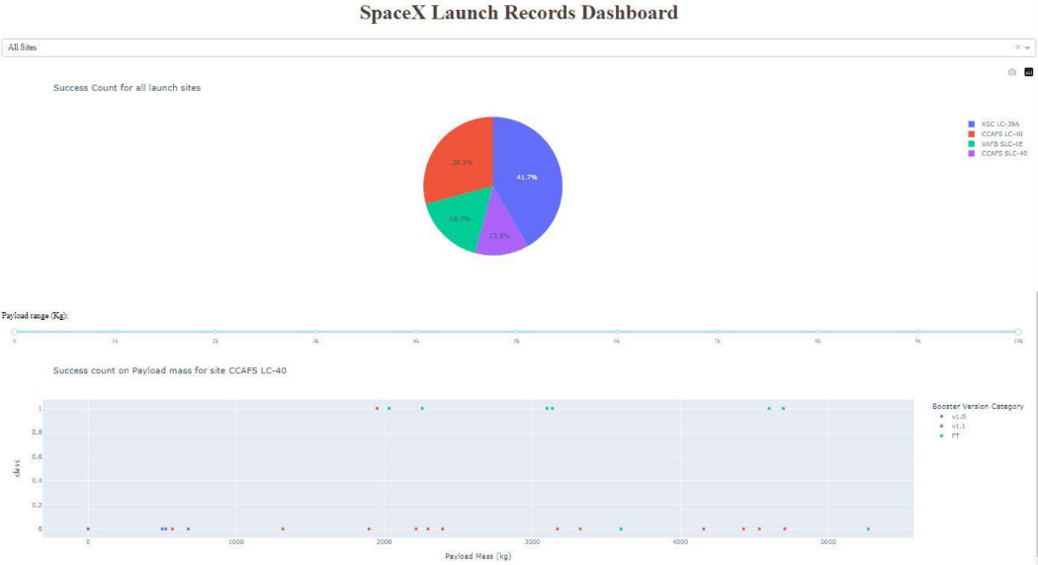
SpaceX Dash App

Slide 18
Predictive Analysis (Classification)
To find the best ML method that would performs best using the test data between SVM, Classification Trees, k nearest neighbors and Logistic Regression were did next steps:
Was created an object for each of the algorithms then created a GridSearchCV object and assigned them a set of parameters for each model.
For each of the models under evaluation, the GridsearchCV object was created with cv=10, then fit the training data into the GridSearch object for each to Find best Hyperparameter.
Next, after fitting the training set, was outputed GridSearchCV object for each of the models, then displayed the best parameters using the data attribute best_params_and the accuracy on the validation data using the data attribute best_score
Next, using the method score, was calculate the accuracy on the test data for each model and plotted a confussion matrix for each (using the test and predicted outcomes).
The GitHub URL of completed predictive analysis lab: https://github.com/Anastasiia-Che/Space-X-Falcon-9-First-Stage-Landing-Prediction/blob/main/SpaceX_Machine%20Learning%20Prediction_Part_5.ipynb

Slide 19
Results
Exploratory data analysis results
Interactive analytics demo in screenshots
Predictive analysis results

Slide 20

Section 2

Slide 21
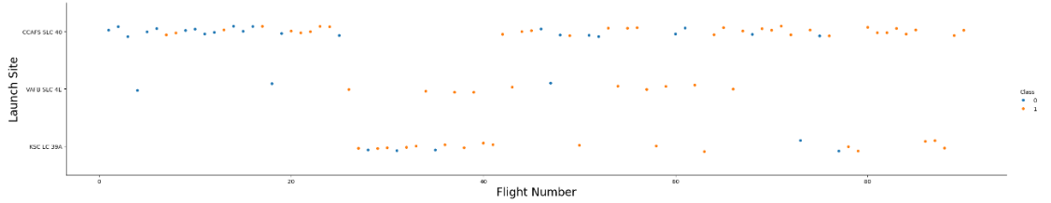
Flight Number vs. Launch Site
A scatter plot of Flight Number vs. Launch Site
Based on the plot above, it's possible to conclusion that the best launch site is CCAF5 SLC 40, where most of recent launches were successful.
In second place VAFB SLC 4E and third place KSC LC 39A.

Slide 22
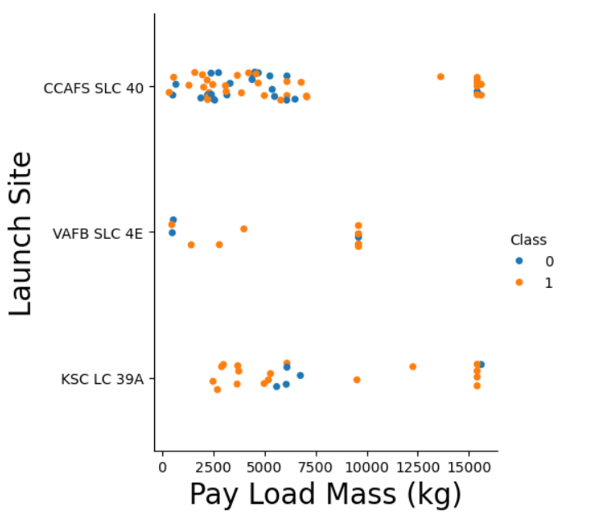
Payload vs. Launch Site
According to the data on the scatter plot of Payload vs. Launch Sit we can conclude:
Payloads over 9,000kg have excellent success rate.
Payloads over 12,000kg seems to be possible only on CCAFS SLC 40 and KSC LC 39A launch sites.

Slide 23

Success Rate vs. Orbit Type
The biggest success rates at 100% have next orbits:
ES-L1
GEO
HEO
SSO
SO orbit has the lowest success rate (0%)

Slide 24
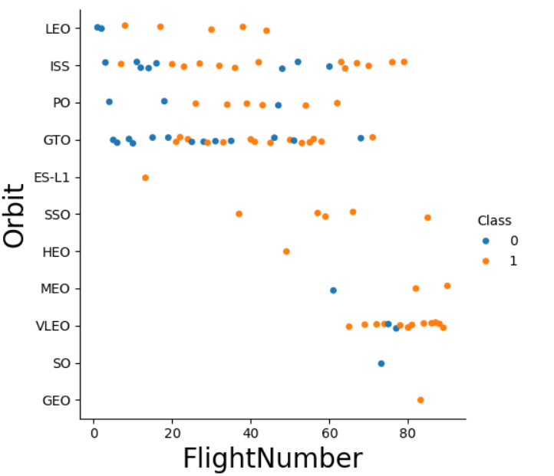
Flight Number vs. Orbit Type
Success rate improved over time to all orbits.
VLEO orbit happened recent increase of its frequency

Slide 25
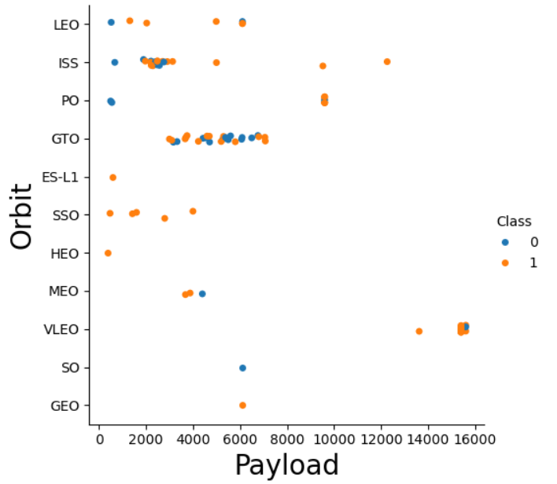
Payload vs. Orbit Type
With heavy payloads the successful landing or positive landing rate are more for Polar, LEO and ISS.
ISS orbit has the widest range of payload and a good rate of success;
There are only few launches to the orbits SO and GEO

Slide 26
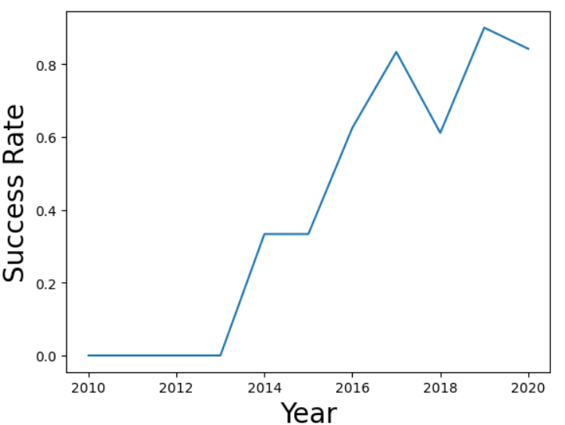
Launch Success Yearly Trend
Since 2013 the success rate kept going up till 2020

Slide 27
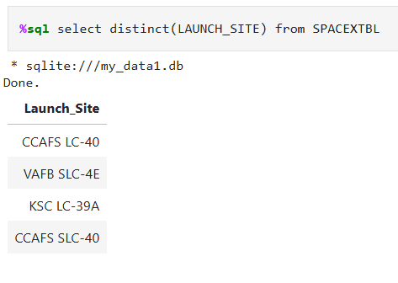
All Launch Site Names
Find the names of the unique launch sites
Used ‘Select’ Distinct statement to return only the unique launch sites from the ‘Launch_Site’ column on the SPACEXTBL table

Slide 28
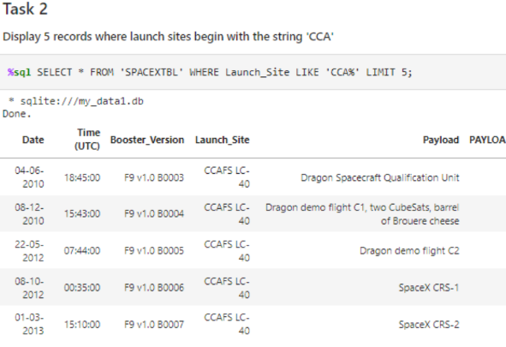
Launch Site Names Begin with 'CCA'
Used 'Like' command with '%' wildcard in 'Where' claise to select and display a table of 5 (used ‘Limit 5’command) records where launch sites begin with `CCA`

Slide 29
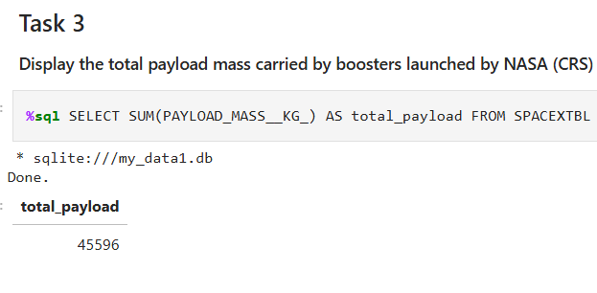
Total Payload Mass
Used the ‘SUM()’ function to return and display the total sum of PAYLOAD_MASS_KG for customer ‘NASA (CRS)

Slide 30
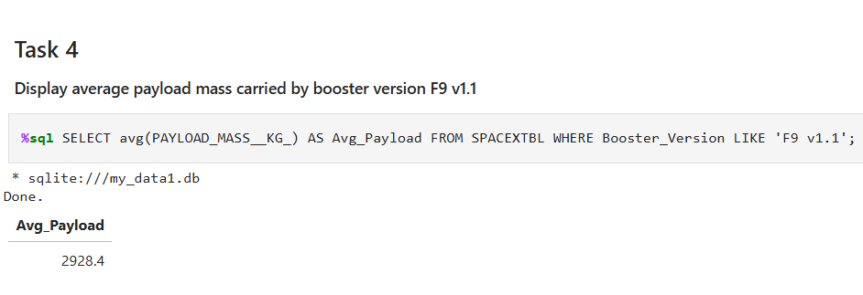
Average Payload Mass by F9 v1.1
Used the ‘AVG()’ function to return and display average payload mass. Obtained the value of 2928,4

Slide 31
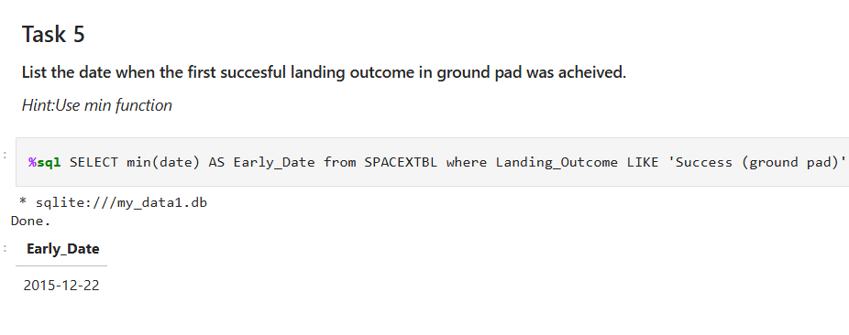
First Successful Ground Landing Date
Used ‘MIN()’ function to return the date when the first successful landing outcome in ground pad was achieve. It’s happened on 22.12.2015

Slide 32
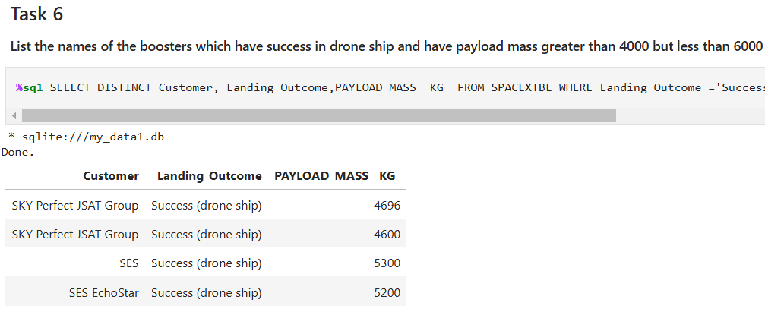
Successful Drone Ship Landing with Payload between 4000 and 6000
Used ‘SELECT DISTINGT’ statement to return and list the unique names

Slide 33
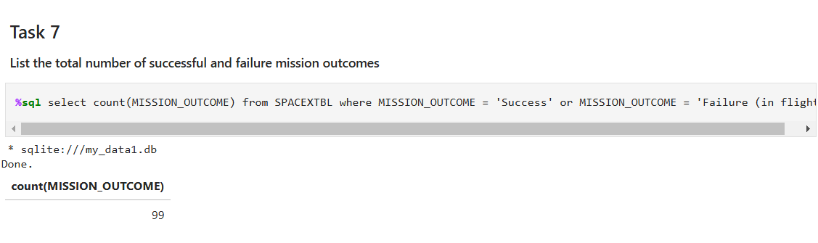
Total Number of Successful and Failure Mission Outcomes
Used the ‘Count’ statement to calculate the total number of successful and failure mission outcomes

Slide 34
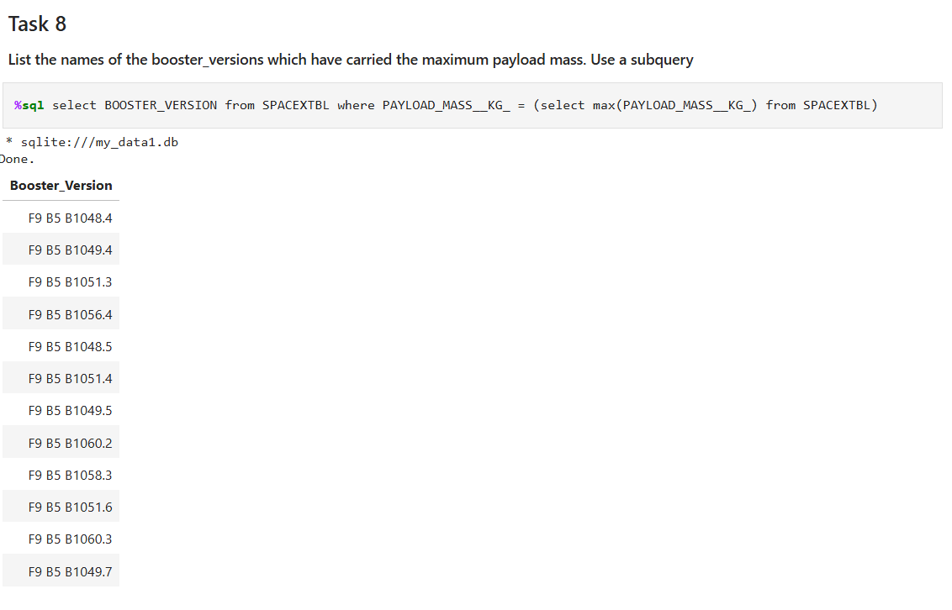
Boosters Carried Maximum Payload
There are the boosters which have carried the maximum payload mass registered in the dataset

Slide 35
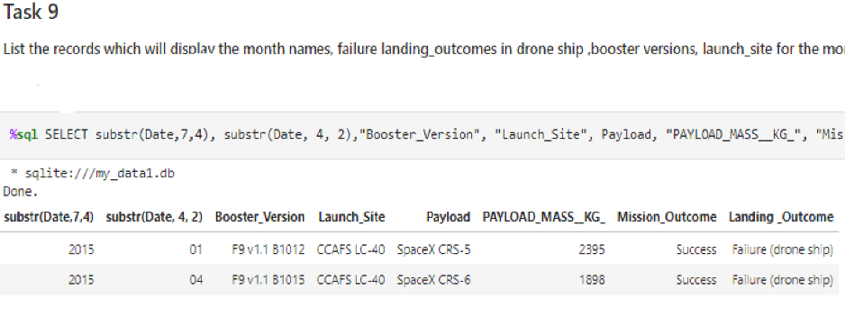
2015 Launch Records
Find the failed landing_outcomes in drone ship, their booster versions, and launch site names for in year 2015

Slide 36
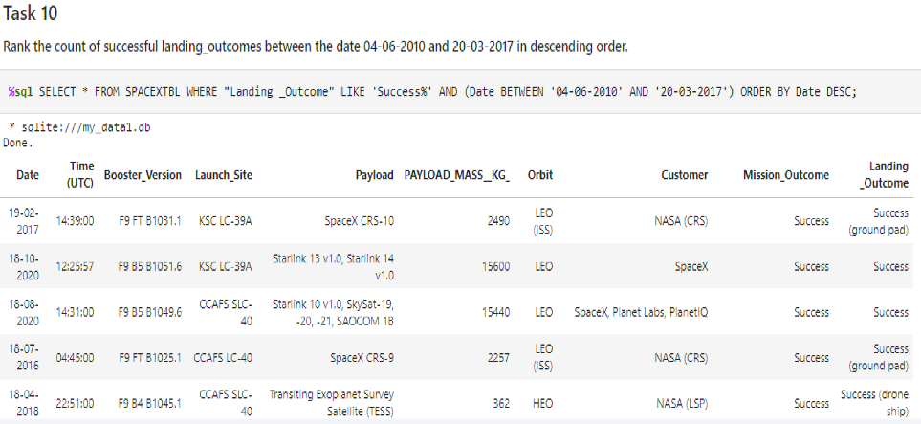
Rank Landing Outcomes Between 2010-06-04 and 2017-03-20
Result of ranking the count of landing outcomes between the date 2010-06-04 and 2017-03-20

Slide 37

Section 3

Slide 38
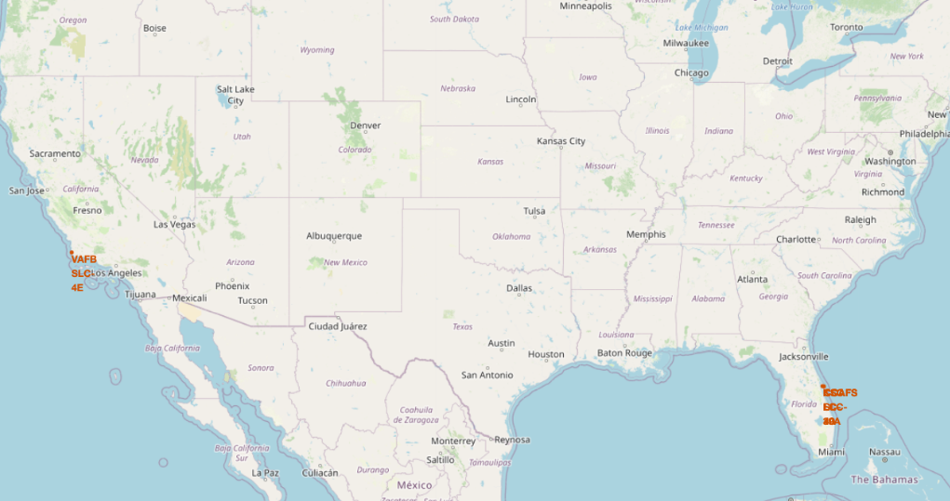
Markers of Launch Sites on Global Map
According to the map, launch sites are near sea. Probably it's by safety and for convenience, but not too far from roads and railroads.

Slide 39
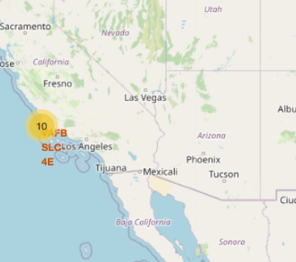
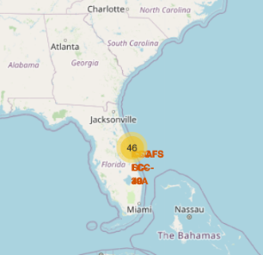
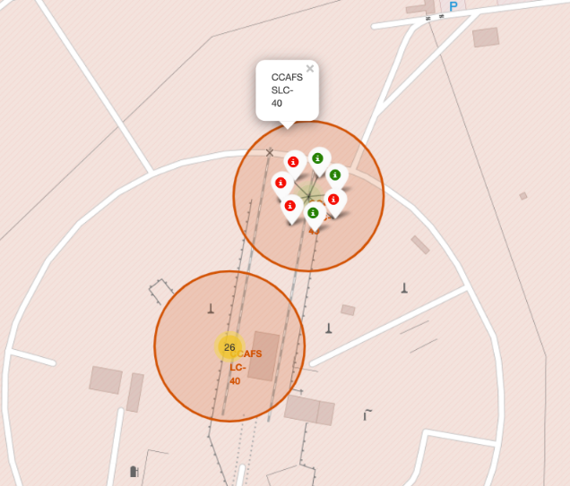
Launch Outcomes for Each Site on the Map
Green marker used if a launch was successful
Red marker used if a launch was failed

Slide 40

The Distance Between a Launch Site to Its Proximities
The distances between the coastline point and the launch site is 86.7km

Slide 41

Section 4

Slide 42
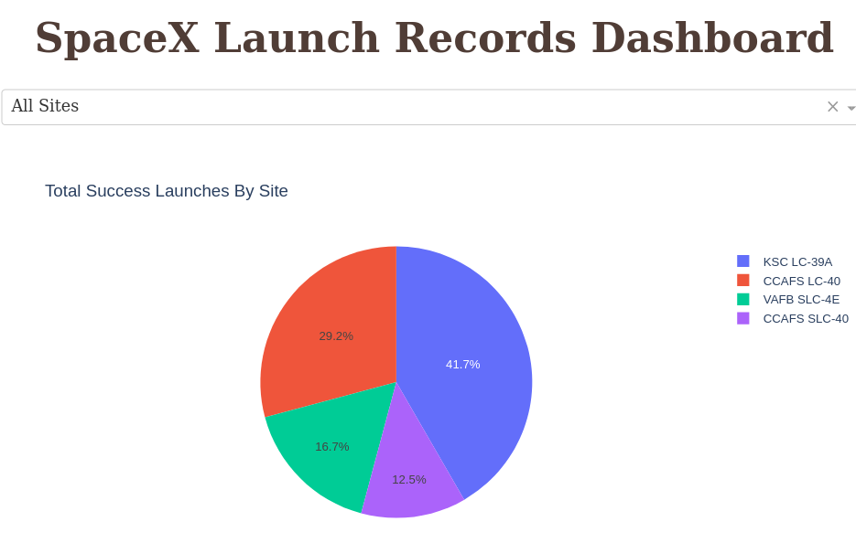
Successful Launchers by Site
Launch site KSC LC-39A has the highest launch success rate at 42% followed by CCAFS LC-40 at 29%, VAFB SLC-4E at 17% and lastly launch site CCAFS SLC-40 with a success rate of 13%

Slide 43
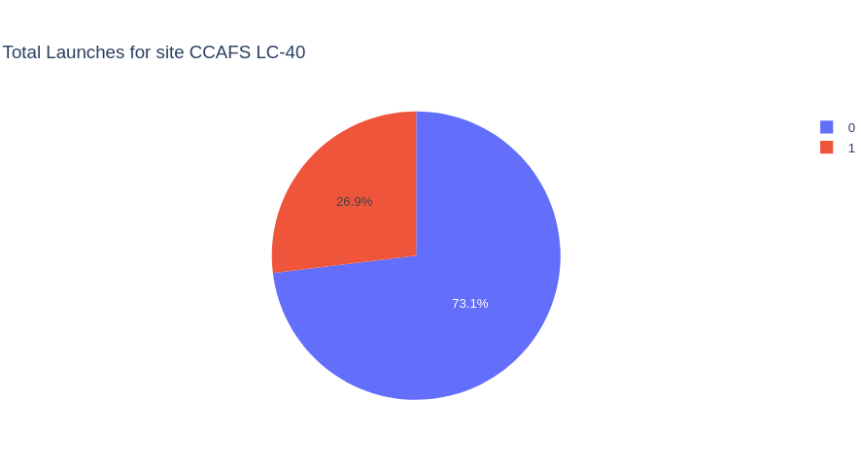
Launch Success Ratio for CCAFS LC-40
Launch site CCAFS LC-40 had the second highest: success ratio of 73% success against 27% failed launches

Slide 44
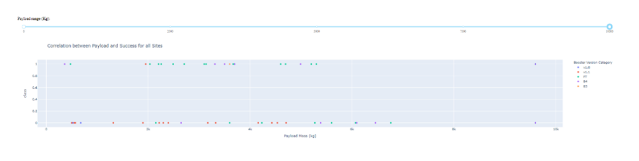
Payload vs. Launch Outcome
For Launch site CCAFS LC-40 the booster version FT has the largest success rate from a payload mass of >2000kg

Slide 45

Section 5

Slide 46
Classification Accuracy
All the methods perform equally on the test data. They all have the same accuracy of 0.83333 on the test Data

Slide 47
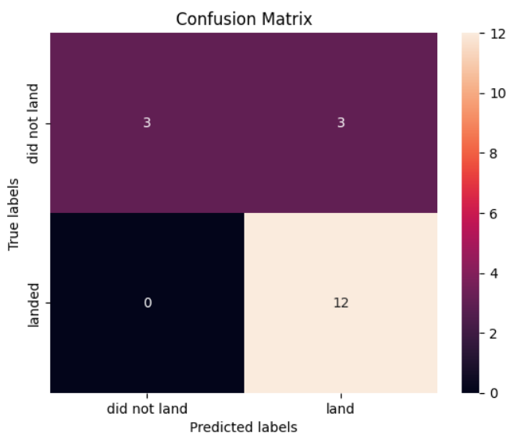
Confusion Matrix
All the four classification model had the same confusion matrixes and were able equally distinguish between the different classes. The main problem is false positives for all the models

Slide 48
Conclusions
Different launch sites have different success rates. KSC LC-39A and VAFB SLC 4E has a success rate of 77%, while CCAFS LC-40, has a success rate of 60 %.
With the flight number increases in each of the third launch sites, so does the success rate. For example, KSC LC 39A and CCAFS SLC 40 have a 100% success rates after 80th flight.
Orbits ES-L1, GEO, HEO & SSO have the highest success rates at 100%, with SO orbit having the lowest success rate at -50%. Orbit SO has 0% success rate.
With heavy payloads the successful landing or positive landing rate are more for Polar, LEO and ISS. However for GTO we cannot distinguish this well as both positive landing rate and negative landing (unsuccessful mission) are both there here.
The success rate since 2013 kept increasing till 2020.

Slide 49


